Slide 1
Algorithms and Data Structures (CIS1002-N)
Week 1:Intro and Arrays
Module Leader: Dr Annalisa Occhipinti
Email: A.Occhipinti@tees.ac.uk

Slide 2
Algorithms and Data Structures
Module Aims:
To introduce fundamental data types and data structures.
To constructs and analyse new algorithms and increase your confidence in problem-solving.
Introduce formal concepts to measure algorithms’ complexity.
Build upon the skills acquired in Java and Problem-Solving.

Slide 3
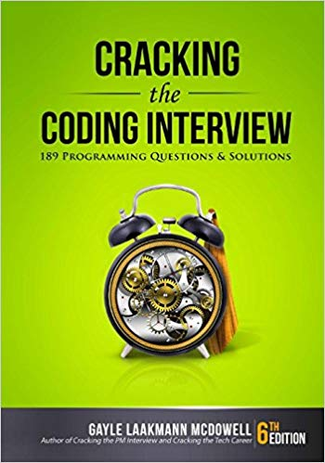
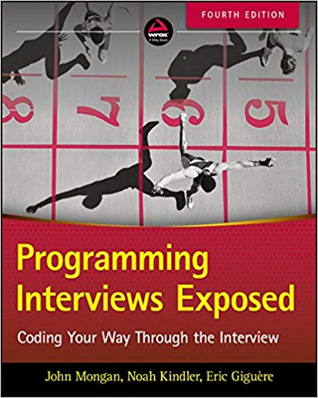
Why do you need to study this module?

Slide 4
Timetable

Slide 5
Approach to Teaching
Lectures/Seminars (2 Lectures – 1h each) | presentation of concepts and theories (Java & pseudo-code) work and practice on algorithmic problems to embed knowledge
Lab Sessions (2h – once a week) | Algorithmic design Java Implementation

Slide 6
Approach to Teaching
You will be required to do work outside the class-time.
Bring pen, paper and your iPad to each lesson (or have it next to you at home).
Even more…
You must attend all lectures, seminars and labs.
You must ensure you complete the practical sheet every week by working between class sessions.
This module is fundamental to your career and will form the basis of most job interviews.

Slide 7
Assessment
Component 1 (80%): Programming Tasks to assess the quality of the algorithms’ implementation.
Component 2 (20%): End-Quiz to show your understanding of the topics in the wider context of Computer Science.
Please check the ICA Document on Blackboard under Assessment

Slide 8
Schedule and Topics covered
Week | Lecture (1hour x 2) – Lab Session (2hours)
Week 1 | Introduction to Algorithms and their related Data-Structures – Array ADT
Week 2 | Sorting : Bubble sort, Selection sort and Shuttle sort
Week 3 | Sorting : Cocktail Shaker sort and Insertion sort, Introduction to O-notation
Week 4 | Singular Linked-lists
Week 5 | Doubly Linked-lists and Circular Linked-lists
Week 6 | Stacks
Week 7 | Queues
Week 8 | Recursion
Week 9 | Recursion
Week 10 | Recursion
Week 11 | Trees and balanced trees
Week 12 | Merge Sort and Quick Sort
Note: The schedule may be adjusted based on class progress.

Slide 9
What do you need to do?
Ask questions (feel free to interrupt me if you need any clarification);
Interact and be active in your learning (Learning is not a spectator sport!);
Take responsibility for your learning;
Solve all exercises (lectures and labs);
Do extra work (read recommended books, etc);
Respect everyone else.
Anything bothering you? Struggling? Get in touch with me!

Slide 10
Reading list
Essential (available in the Library)
Carrano F., Data Structures and Abstractions with Java, 4th edition (International edition), 2016
Cormen T., Leiserson C., Rivest R., Stein C., Introduction to Algorithms. MIT Press, 3rd edition 2009 – Useful for the Test
Goodrich, Michael T., Roberto Tamassia, and Michael H. Goldwasser. Data structures and algorithms in Java. John Wiley & Sons, 2014. – Includes a nice intro on Java
Recommended
Weiss M., Data Structures and Algorithm Analysis in Java, 3rd Edition (International edition), 2012
Prichard J., Carrano F., Data Abstraction and Problem Solving with Java: Walls and Mirrors, 3rd edition (International Edition), 2011
Cormen T., Algorithms Unlocked, MIT Press, 2013
Knuth, D. E. The Art of Computer Programming. Vol 1: Fundamental algorithms. 3rd ed. Addison-Wesley, 1997.

Slide 11
Before we start…
Any January starters? Anyone who hasn’t done the Java module in semester 1?
Please stay behind at the end of this session
(you’re not in trouble ☺)

Slide 12
Today’s plan
Introducing abstract-data types
Our first abstract data-structure: the Array ADT

Slide 13
Rationale
Gain analytical and good programming skills.
Solve more complex problems by using data structures.
Provide an appreciation of the use and importance of data structures and related algorithms.
A range of well-established data structures will be examined:
Arrays, Linked-lists, Stacks, Queues, Trees (Binary, and non-binary), etc.
A variety of algorithmic techniques:
Sorting, Searching, Recursion, Indexing.

Slide 14
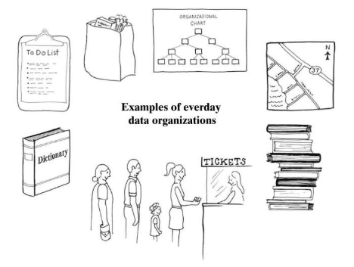
What are “Data Structures”?
Everything around us is organised in a specific way
Data Structures are the way we are able to store and retrieve data
Data Structures allow us to organise information in a digital space.

Slide 15
Data structures operations
Important basic operations are:
Accessing – no point having stored data if you can’t use it.
Inserting – new data may have to be added – e.g. new child changes structure of family tree.
Deleting – inverse of inserting but similar characteristics.
Searching – problem here is to search the data structure for a node with a certain value in some field (field of node being searched is called a key).
This is similar to accessing, but identification of a required node by its contents rather than by its position raises different issues for most data structures.
Sorting – in some applications the nodes must be sorted into some order according to a particular key.

Slide 16
To Use Data Structures we need…Abstract Data Types
Do you remember any data type (in Java, Python or in CS in general)?
A Data Structure is
the construct within a programming language that stores this collection of data.
The data is accessed or modified through these operations.
An Abstract Data Type is:
a collection of data.
a set of operations on that data.
Different possible implementations means we can optimise performance!

Slide 17
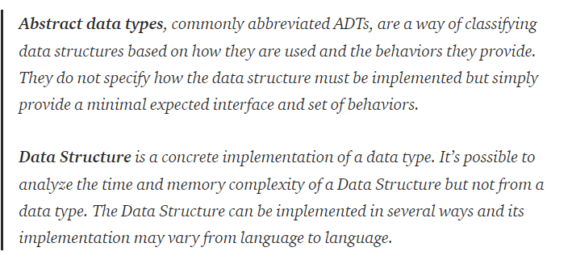
ADT and Data Structures
Notes:
https://medium.com/@lucasmagnum/sidenotes-array-abstract-data-type-data-structure-b154140c8305

Slide 18
Abstract Data Type (ADT) alternative definition
Defined as:
The specification of a set of
data-management operations together with the
data values upon which they operate
Member methods
Data members

Slide 19
Concrete and Abstract Data Structures
Two ways of thinking about data structures:
Concrete: concerned with addresses in physical memory.
Abstract: concerned only with abstract operations supported.
Examples:
Concrete: arrays, linked-lists.
Abstract: sets, stacks, queues, dictionaries, trees, graphs.
Implementing abstract structures is still governed by the concrete structures within our computer.

Slide 20
Array as ADT

Slide 21
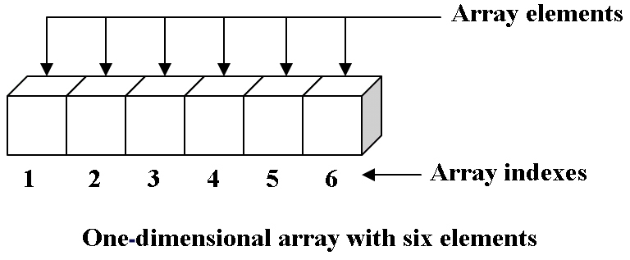
Array as ADT
The array is a basic abstract data type that holds an ordered collection of items accessible by an integer index.
Arrays have one property: they store and retrieve items using an integer index.
If you are going to implement this in Java…do you notice anything wrong in this image?
Notes:
https://brilliant.org/wiki/arrays-adt/

Slide 22
Array - definitions
An array is a sequence of indexed components.
The length of the array is fixed when the array is constructed.
Each component has a unique index.
array indexes:
0 1 2 3 4 … k-1 … MAX_SIZE -1
array elements:
12
3
6
23
80
…
18
10
?
?
…
?

Slide 23
A quick Recap about arrays in Java
You’ve used arrays before,
but a quick recap… arrays:
Are a fixed size once
instantiated
Are accessed by indexing them (more in this in a moment)
Array elements/members are (usually) contiguous (next to each other) in memory
// Declaring an array.
int[] myNumbers;
// Instantiating the array. myNumbers = new int[10];
// Getting the first member.
int first = myNumbers[0];
// Getting the last member. int last = myNumbers[9];
// Will this work?
int x = myNumbers[-1];
// How about this?
int y = myNumbers[10];

Slide 24
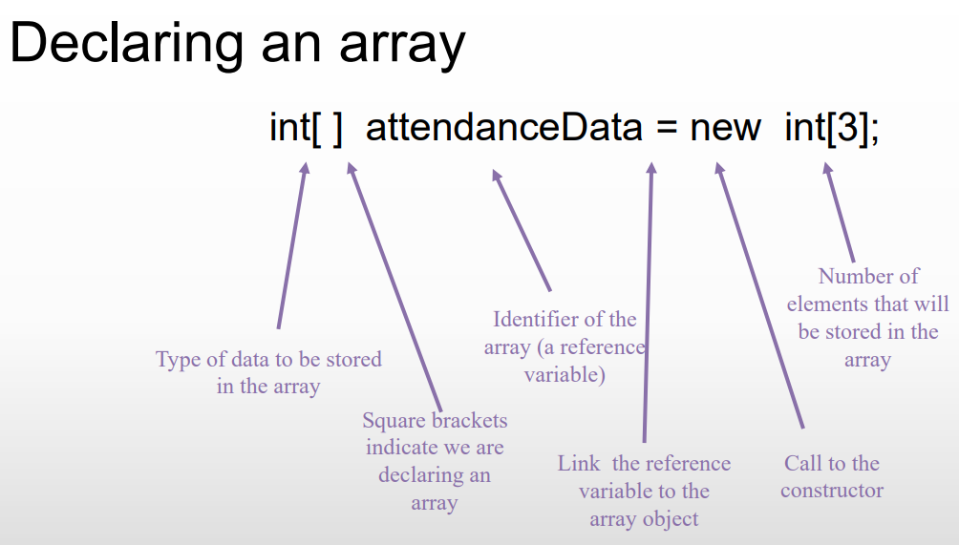
You’ve seen this before!
The Java array type is an example of an implementation of the array abstract data type.

Slide 25
A quick Recap about arrays in Java
Demo using the main class
Create an array of 5 elements
Set the first element equal to 3
Set the second element equal to 5
Print the array
Print the size of the array
Return the item at index 2
Or…we can create an array ADT (abstract data structure) to make these tasks much easier and faster!
Notes:
import java.util.Arrays;
Arrays.toString()
Array.legnth

Slide 26
Array ADT
A collection of identically typed entities:
12
3
6
23
80
34
18
10
25
10
5
40
A
G
L
R
O
I
H
T
A
S
M
L
Remember:
An abstract data type (ADT) is one whose underlying
implementation is invisible to the procedures that use it.
Instead, they manipulate the data structure via a number
of predefined methods.

Slide 27
Array - examples
Colour3i
0
255
127
Vector3D
2.4
3.1
5.7
1.0
pointer / reference-variables to Agent instances
Agent
Agent
Agent
Agent
Agent

Slide 28
Array ADT - Operations
Operations
Create an empty array
Determine whether the array is empty
Determine the number of items currently in the array
Insert a component at a given position in the array
Retrieve the component at a given index in the array
Delete a component at a given position in the array

Slide 29
Let’s create your first Array ADT
public class ArrayADT {
private int[] data;
private int numberOfEntries;
public ArrayADT(int size) {
data = new int[size];
}
public void method(){
// TODO: What goes here?
}
}
Implement a method to print the new ArrayADT data type

Slide 30
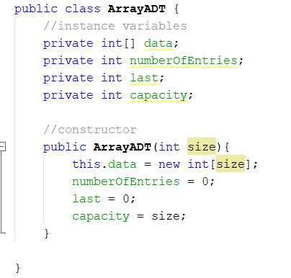
Example 1: Array ADT – a simple example
Data Type
Array Collection of actual components
NumOfEntries of the array (logical size)
Capacity number of components (physical size, capacity)
Last component index
Main methods
Boolean add(integer o): inserts a new element o – return false if the array is full
remove(integer i): removes the element at index i (replace it with zero)
isFull(): returns true if the array is full or false if not.

Slide 31
Example 2: Array ADT a more complex example
Data Type
Collection of actual components
Capacity max number of components (physical size)
NumOfEntries of the array (logical size)
Last component index
• Main methods
get(integer i): returns the element at index i without removing it
set(integer i, object o): replaces the element at index i with o and returns the old element
add(integer i, object o): inserts a new element o to have index i
remove(integer i): removes and returns the element at index i
• Additional methods
size(): returns the number of elements in this list
isEmpty(): returns true if this list contains no elements
getFrequencyOf(integer i): returns the number of times the integer i is in the array.

Slide 32
Advantages of Arrays
Arrays are generally space efficient when the user knows in advance approximately how large the set of components will evolve to.
No wasted space for an individual component.
Data is tightly packed together, making for efficient and quick access

Slide 33
Disadvantages of Arrays
Their size must be pre-determined before the array can be allocated.
Arrays can grow beyond their pre-determined size.
When the array contains only a few components, a substantial amount of space might be tied up in a large empty array.

Slide 34

Quizzes!

Slide 35
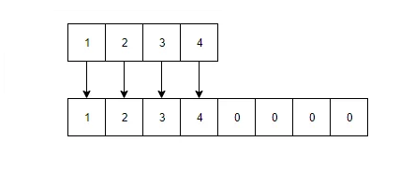
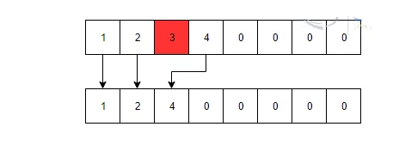
Dynamic Arrays - Operations
Add an element to a Dynamic array:
8
Remove an element from a Dynamic array:
Notes:
https://examples.javacodegeeks.com/dynamic-array-java-example/

Slide 36
Insertion (1)
Insert element 12 at index position 5
12
0 1 2 3 4 5 6 7 8 9
12
3
6
23
80
45
18
10
?
?

Slide 37
Insertion (2)
Insert element 12 at index position 5
12
0 1 2 3 4 5 6 7 8 9
12
3
6
23
80
45
18
?
10
?

Slide 38
Insertion (3)
Insert element 12 at index position 5
12
0 1 2 3 4 5 6 7 8 9
12
3
6
23
80
45
?
18
10
?

Slide 39
Insertion (4)
Insert element 12 at index position 5
12
0 1 2 3 4 5 6 7 8 9
12
3
6
23
80
?
45
18
10
?

Slide 40
Insertion (5)
Insert element 12 at index position 5
?
0 1 2 3 4 5 6 7 8 9
12
3
6
23
80
12
45
18
10
?

Slide 41
Dynamic arrays
Advantages:
allow the programmer to get around the limitation on the standard array that its size cannot be changed once the array has been created.
this means that space does not need be allocated to the dynamic array until it is to be used.
Disadvantage:
It takes time to deal with space adjustments on the array. Each time the array grows in size, its contents must be copied.

Slide 42
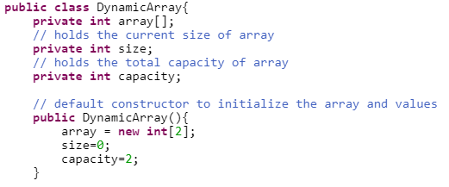
Dynamics array in Java – useful for labs

Slide 43
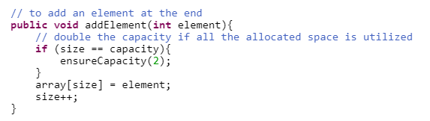
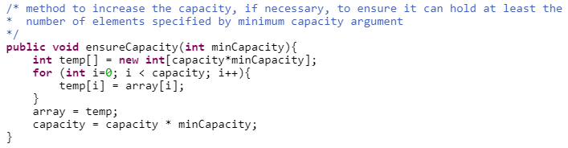
Dynamic Arrays in Java – useful for labs
Add an element to a Dynamic array:
Notes:
https://examples.javacodegeeks.com/dynamic-array-java-example/

Slide 44
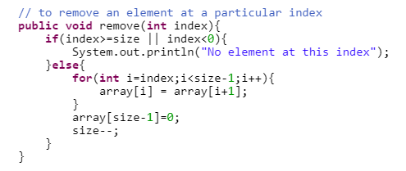
Dynamic Arrays in Java – useful for labs
Remove an element from a Dynamic array:
Notes:
https://examples.javacodegeeks.com/dynamic-array-java-example/

Slide 45

QUESTIONS?
a.occhipinti@tees.ac.uk

Slide 46
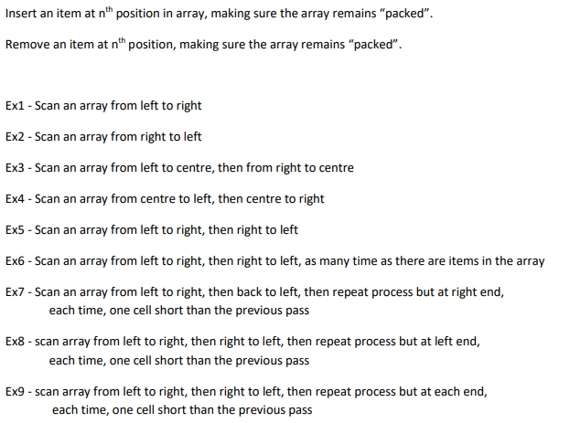
Homework: Interview Question
Write the Java code to implement the method below:
Boolean insertPacked(int item, int index)
Share your solutions here: https://padlet.com/a_occhipinti/1086vl4mjfcz

Slide 47
Exercises. Write the pseudo-code for…

